Slide 1
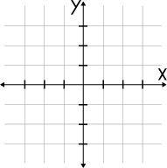


y
Project Title: Combinatorial Optimization Solver
Subtitle: Part 1-Traveling Salesperson Problem (TSP)
Name: Prottoy Paul
Roll: 1613
Course: SE 2105
x
Supervisor: Shah Mostafa Khaled , PhD

Slide 2
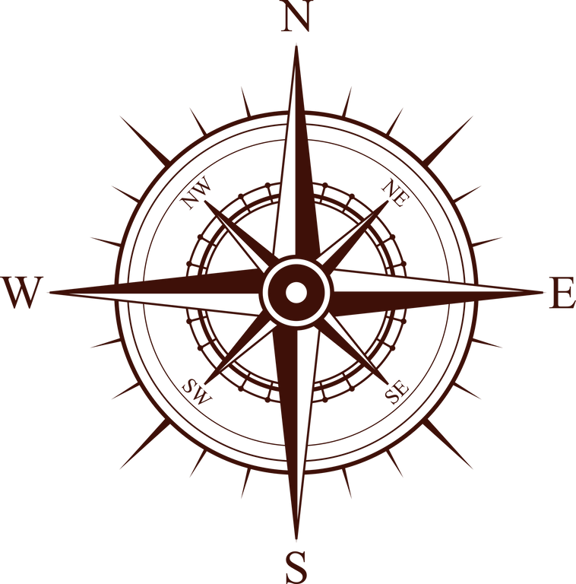
Project Overview
Goal: Solve complex math problems using code.
Current Status: TSP Solver (Completed).
Next Phase: 0/1 Knapsack Solver (Upcoming).
Languages Used:
Java: For the User Interface (UI).
C Language: For the fast calculations (Backend).

Slide 3
The Problem (TSP)
Question: "How to visit N cities and return home using the shortest path?"
The Challenge:
10 Cities = 180,000 paths.
12 Cities = 479 Million paths.
20 Cities = Impossible for normal computers.

Slide 4
Algorithm 1 - Branch and Bound
Type: Exact Algorithm.
Accuracy: 100% (Perfect Solution).
How it works:
Uses a "Lower Bound" to guess the cost.
Pruning: If a path looks expensive, it cuts it off immediately.

Slide 5
Algorithm 2 - Ant Colony Optimization
Type: Heuristic (Approximation).
Inspiration: Real ants finding food.
Why use it?
Branch and Bound is too slow for 50+ cities.
Ant Colony is fast.
Key Concept: Pheromones (Scent trails).

Slide 6
Comparison (My Result)
Table:
Small Input (N=12): Branch & Bound is better (100% Accurate).
Large Input (N=20+): Ant Colony is better (Does not crash).
Trade-off: Speed vs. Accuracy.

Slide 7
Future Work (The Knapsack Problem)
Status: Upcoming (Phase 2).
Problem: 0/1 Knapsack.
Goal: Select items to maximize profit without breaking the bag.
Plan: Implement using Branch & Bound and Dynamic Programming (DP) in the same C backend.

Slide 8
Conclusion
Summary:
TSP Solved successfully.
Comparison of Exact vs. Heuristic done.
Ready for Phase 2 (Knapsack).
Thank You!

